Slide 1
Susceptible, Infected, Recovered:
the SIR Model of an Epidemic
susceptibles
infecteds
recovereds
S
Get sick
I
Get better
R
I*β
γ
Infection rate
Recovery rate

Slide 2
What is a Mathematical Model?
a mathematical description of the real-world
focuses on specific quantitative features of the scenario, ignores others (simplification)
involves hypotheses that can be tested against real data

Slide 3
Why Study Epidemic Models?
To supplement statistical extrapolation.
To learn more about the qualitative dynamics of a disease.
To test hypotheses about, for example, prevention strategies, disease transmission, significant characteristics, etc.

Slide 4
Why SIR models?
Infectious diseases kill millions of people world-wide
Malaria, TB, HIV/AIDS
New diseases emerge suddenly and spread quickly
SARS, West Nile Virus, HIV, Avian Influenza…
Effective and fast control measures are needed
Models allow you to predict (estimate) when you don’t KNOW
What are the costs and benefits of different control strategies?
When should there be quarantines?
Who should receive vaccinations?
When should wildlife or domestic animals be killed?
Which human populations are most vulnerable?
How many people are likely to be infected? To get sick? To die?

Slide 5
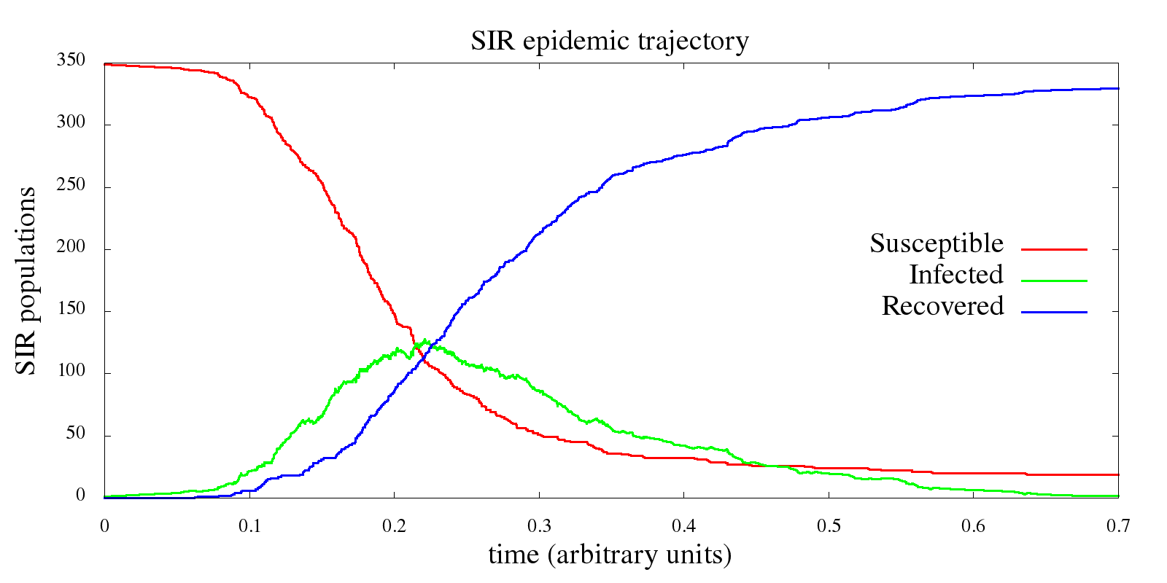
The SIR Epidemic Model
Consider a disease spread by contact with infected individuals.
Individuals recover from the disease and gain further immunity from it.
S = fraction of susceptibles in a population
I = fraction of infecteds in a population
R = fraction of recovereds in a population
S + I + R = 1

Slide 6
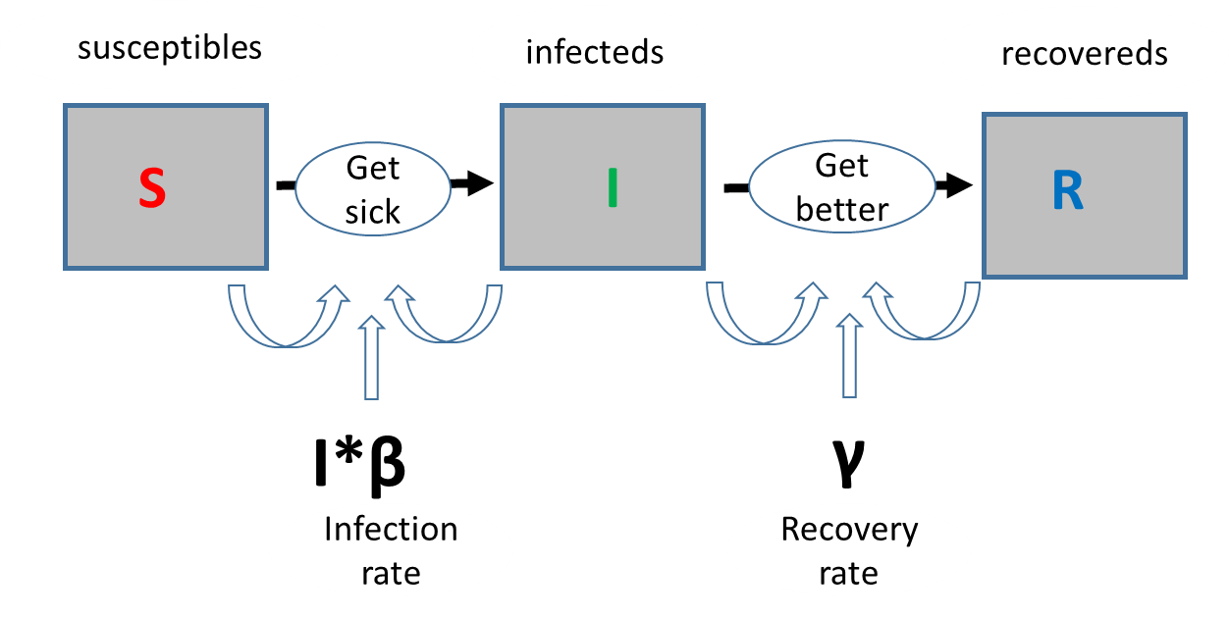
Simple SIR Model
Susceptibles (S) have no immunity from the disease.
Infecteds (I) have the disease and can spread it to others.
Recovereds (R) have recovered from the disease and are immune to further infection.
Kermack & McKendrick, 1927

Slide 7
Parameters of the Model
I*beta= the infection rate
gamma= the removal rate
The basic reproduction number is obtained from these parameters:
N_{R} = infection rate / removal rate
This number represents the average number of infections caused by one infective in a totally susceptible population. As such, an epidemic can occur only if N_{R} > 1.

Slide 8
Vaccination and Herd Immunity
If only a fraction S₀ of the population is susceptible, the reproduction number is N_{R}S₀, and an epidemic can occur only if this number exceeds 1.
Suppose a fraction V of the population is vaccinated against the disease. In this case, S₀=1-V and no epidemic can occur if
V > 1 – 1/N_{R}
The basic reproduction number N_{R} can vary from 3 to 5 for smallpox, 16 to 18 for measles, and over 100 for malaria [Keeling, 2001].

Slide 9
What if ‘R’ isn’t realisitic?
Susceptibles (S) have no immunity from the disease.
Infecteds (I) have the disease and can spread it to others.
susceptibles
infecteds
S
Get sick
I
If there is no immunity after being sick, individuals cycle between S and I. What do we then need to add to the model?
I*β
Infection rate

Slide 10
Enhancing the SIR Model
Can consider additional populations of disease vectors (e.g. fleas, rats).
Can consider an exposed (but not yet infected) class, the SEIR model.
SIRS, SIS, and double (gendered) models are sometimes used for sexually transmitted diseases.
Can consider biased mixing, age differences, multiple types of transmission, geographic spread, etc.
Enhancements often require more compartments.

Slide 11
Norovirus, Fall 2017

Slide 12
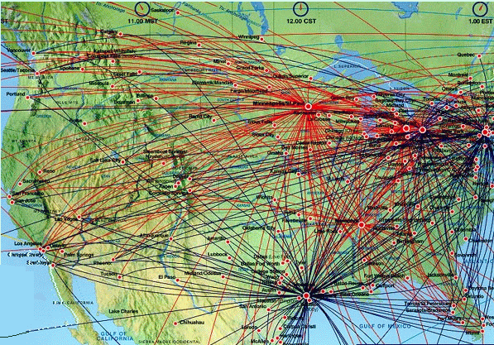
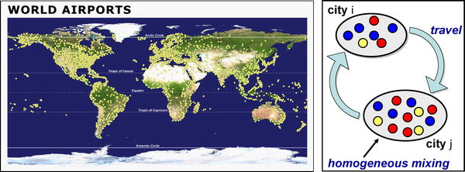
The effect of the airline transportation network
Main modeling features (SARS, H1N1, etc.):
SIR model with empirical population
and airline traffic/network data
homogeneous mixing within cites
network connections and stochastic
transport between cities
Colizza et al. (2007) PLoS Medicine 4, 0095

Slide 13
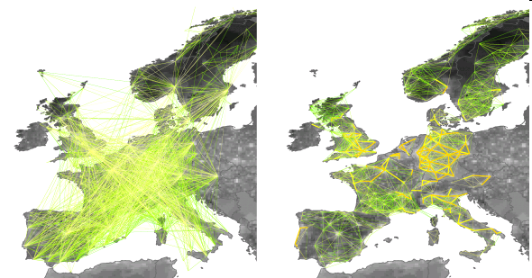
H1N1 Flu http://www.gleamviz.org/
Mobility networks in Europe (network-coupled SIR model):
Left: airport network; Right: commuting network.

Slide 14
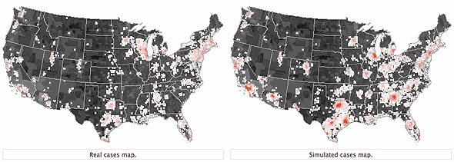
H1N1 Flu http://www.gleamviz.org/
http://www.gleamviz.org/2009/09/us-early-outbreak-real-vs-simulated-geographic-pattern/
http://www.gleamviz.org/2009/09/us-winter-projections-mitigation-effect-of-antiviral-treatment/

Slide 15
Today’s Agenda
Work with Stamps Flu Data
Examine the data going into the model
Think: What can it capture? What’s it leaving out?
Run statistical models in R
Get practice thinking about what each of your variables means biologically, and what you can (and cannot say) using them
Start basic coding of stats and graphs from which to draw conclusions of biological relevance
Think: What variables am I using, and why? Do my graphs tell the same story as my stats? What do I get by using both?
Work with Stamps Norovirus Data
Examine the data going into the model
Again, Think: What can it capture? What’s it leaving out?
Run Spatial Analysis
Get practice using spatial tools, and think about how this information can inform SIR models
Practice cleaning up data for more complex analysis, and argue for proposed health interventions based on your evidence (data and models)
Think: What data is most important here? How does the prognosis improve, based on my models, if I were to change a certain parameter through a specific intervention?
Notes:
Link to example storymap: https://www.arcgis.com/apps/Cascade/index.html?appid=7e0f3366579443ab9ad6c5b0156dea7b

Slide 16
References
J. D. Murray, Mathematical Biology, Springer-Verlag, 1989.
O. Diekmann & A. P. Heesterbeek, Mathematical Epidemiology of Infectious Diseases, Wiley, 2000.
Matt Keeling, The Mathematics of Diseases, http://plus.maths.org, 2004.
Allyn Jackson, Modeling the Aids Epidemic, Notices of the American Mathematical Society, 36:981-983, 1989.

